Slide 1
Grouping and Summarizing Data
Joseph Rudolf
AACC 2021
Notes:
Greetings everyone.
In this session we are going to cover an introduction to R, Rstudio, and R Markdown.

Slide 2
Notes:
@@ Add new schedule slide

Slide 3
Goals
Learn how to summarize data and assess hypotheses
Objectives
Calculate a summary statistic for a variable using `summarize`
Calculate of summary statistic for a variable separately for a group of observations, using `group_by` and `summarize`
Perform a simple test for association
Notes:
@@ reconcile goals and objectives

Slide 4
Typical Data Science Pipeline
From R for Data Science (https://r4ds.had.co.nz/introduction.html)
Notes:
In this session we will focus on modeling. But, in the process, we will do a lot more data transformation

Slide 5
Summarize()

Slide 6


summarize()
Make summaries of your data
Notes:
Apply a function (or functions) to all observations of a variable and return a single value, or summary.

Slide 7
summarize()
Make summaries of your data
covid_testing %>%
summarize(new_variable = calculation)
name for new variable
Value or function

Slide 8
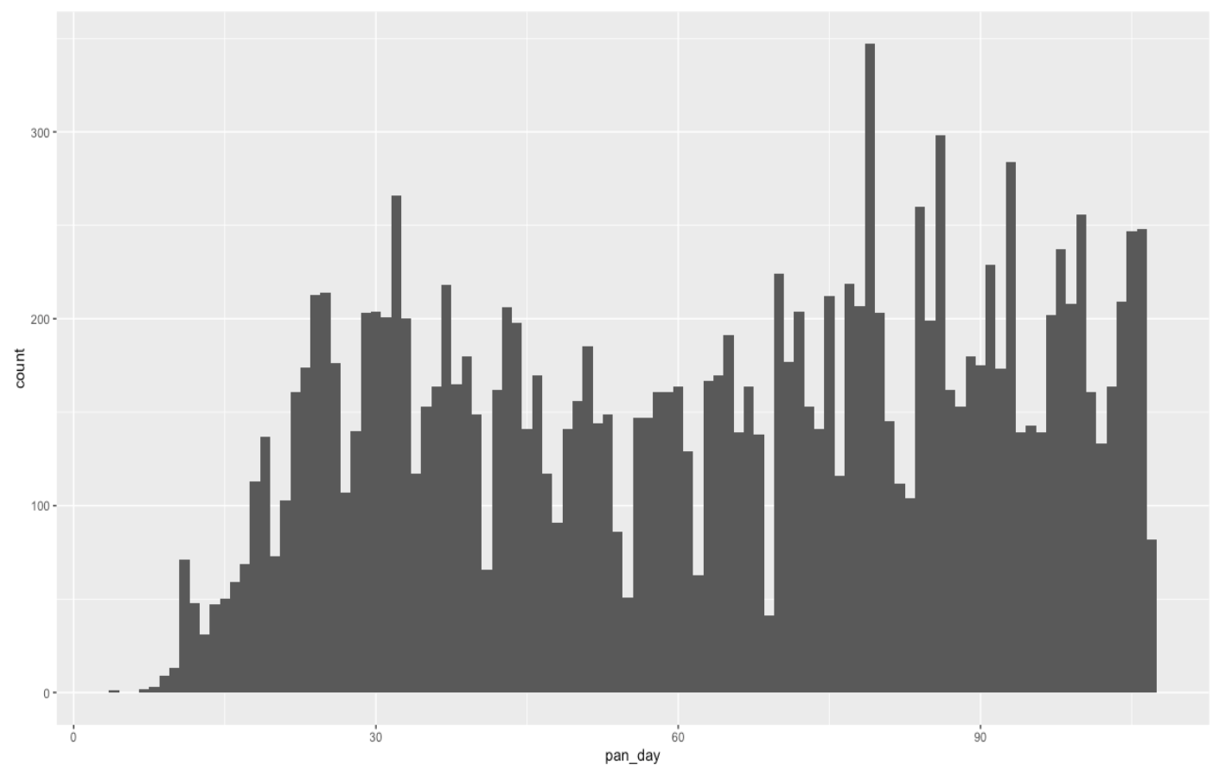
Q: How many tests are ordered per day?

Slide 9
summarize()
function that returns number of observations
Make summaries of your data
covid_testing %>%
select(mrn, pan_day) %>%
head(4) %>%
summarize(order_count = n())
mrn | pan_day
5001412 | 4
5000533 | 7
5009134 | 7
5008518 | 8
order_count
4
Notes:
Note, that to simplify the data frame, we first will select 2 variables and include the first 4 observations.
n() returns the number of observations or rows for a data frame.

Slide 10
summarize()
function that returns number of distinct values
Make summaries of your data
covid_testing %>%
select(mrn, pan_day) %>%
head(4) %>%
summarize(order_count = n(),
day_count = n_distinct(pan_day))
mrn | pan_day
5001412 | 4
5000533 | 7
5009134 | 7
5008518 | 8
order_count
4
day_count
3
Notes:
n_distinct() counts the number of distinct, or unique, observations. So, while there are 4 rows, there are only 3 distinct days

Slide 11
Your Turn #1
- Open “05 – Stats.Rmd”
- Run the setup chunk
- Fill-in gaps to calculate:
a) Mean count of orders per `pan_day`
b) Mean count of orders per clinic
Notes:
8 mins

Slide 12
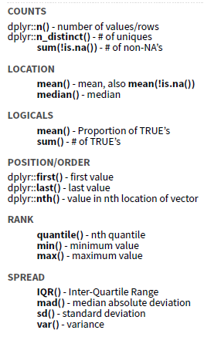
Notes:
There are many different summary functions.

Slide 13
summarize() examples
Last pandemic day (in data)
Median turnaround time
Notes:
n_distinct() counts the number of distinct, or unique, observations. So, while there are 4 rows, there are only 2 distinct patient_id’s.
** CHECK IN: ?too fast or slow? **

Slide 14

Your Turn #2
Consider:
How would you calculate the median number of orders per day?
Notes:
The mean was a special case, because it can be calculated using summarize and not explicitly knowing which order is from which patient. But, to calculate the median (find the mid-point of the observations), we need to be able to assess each patient’s observations separately.

Slide 15
group_by()

Slide 16
group_by()
Notes:
Group_by is a challenging function to master, but extremely powerful. It is one of those tools that once you understand how to use, you cannot possibly go back to live without it.
The idea is simple. I have one big data frame and I want to break the observations up into several groups. Then, I’m going to “look at” those groups separately.

Slide 17
group_by()
Grouping observations based on a specific variable’s values
covid_testing %>%
group_by(variable)
name of variable to group by

Slide 18
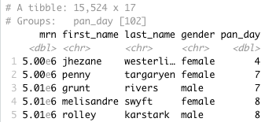
group_by()
Group observations by pan_day
covid_testing %>%
group_by(pan_day)
Notes:
We can see that the resulting object has 15,524 rows that are broken up into 102 groups. Inherently, this means there are 102 distinct `pan_day`’s. Some of these groups will have a single observation. Many of these groups will have more than one observation.

Slide 19
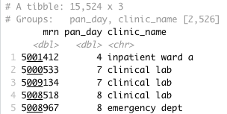
group_by()
Group observations by `pan_day` and `clinic_name`
covid_testing %>%
select(mrn, pan_day, clinic_name) %>%
group_by(pan_day, clinic_name)
Notes:
We can see that the resulting object has 15,524 rows that are broken up into 2,526 groups. Inherently, this means there are 2,526 distinct combinations of `pan_day` and `clinic_name`. Some of these groups will have a single observation. Many of these groups will have more than one observation. Also, not all theoretical combinations of `pan_day` and `clinic_name` exist; only 2,526 such combinations exist.

Slide 20
group_by() %>% summarize()

Slide 21
group_by()
%>%
summarize()
Make summaries of your data by group
Notes:
Just like we can apply summarize() to a full data frame, we can apply summarize() to each group separately.

Slide 22
group_by() %>% summarize()
Make summaries of your data
covid_testing %>%
summarize(order_count = n())
mrn | pan_day
5001412 | 4
5000533 | 7
5009134 | 7
5008518 | 8
order_count
15524
Notes:
Using summarize() without group_by() we can count how many total rows there are.

Slide 23
group_by() %>% summarize()
Make summaries of your data
covid_testing %>%
group_by(pan_day) %>%
summarize(order_count = n())
mrn | pan_day
5001412 | 4
5000533 | 7
5009134 | 7
5008518 | 8
pan_day
4
7
8
9
order_count
1
2
3
9
Notes:
Adding group_by(), we count how many rows there are for each `pan_day`

Slide 24
Your Turn #3
Calculate:
a) The median turnaround time for each day
b) (*Extra*) The median number of orders per day
Notes:
8 mins

Slide 25
group_by() %>% summarize(): Example
Notes:
Number of tests per day. Points for each day. Curve as smoothed point estimate (blue line) and confidence interval (dark gray shading), calculated using local polynomial regression (loess) with default settings.

